Slide 1
CODE OPTIMIZATION TECHNIQUES IN C.D
G. PUNEETH
SHAIK JAMEEL AHAMMAD
SAI SRIKANTH.B

Slide 2
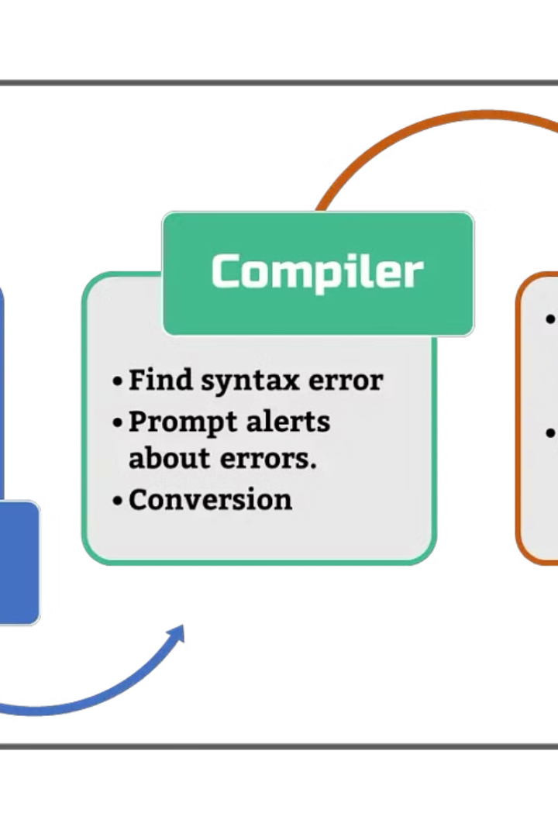
Introduction to Compiler Design
Compiler design is the process of creating software that translates high-level programming languages into machine-readable code. This involves a deep understanding of language syntax, code optimization, and target hardware architecture.

Slide 3
Static Analysis Techniques
Control Flow Analysis
Data Flow Analysis
Examines the order and direction of execution in a program, enabling optimizations and identifying potential errors.
Tracks the flow of data through a program, identifying opportunities for dead code elimination and constant folding.
Type Checking and Inference
Abstract Interpretation
Ensures variables are used correctly and helps catch type-related errors during compilation, improving program reliability.
Approximates the runtime behavior of a program by analyzing its static structure, enabling advanced optimizations.

Slide 4

Control Flow Analysis
Control flow analysis is a fundamental technique in compiler design that examines the possible execution paths within a program
It constructs a control flow graph to represent the flow of control, including conditional branches, loops, and function calls.
This analysis helps identify unreachable code, dead code, and opportunities for code optimizations such as loop unrolling and function inlining.

Slide 5

Data Flow Analysis
1
Identifying Data Dependencies
Data flow analysis examines how data flows through a program, tracking how variables are defined, used, and modified across different control flow paths.
2
Reaching Definitions
The reaching definitions analysis determines which variable definitions can potentially reach a given point in the program, providing insights into data dependencies.
3
Live Variable Analysis
Live variable analysis identifies variables that are "live" at a given program point, meaning their values may be used in the future, enabling optimizations.

Slide 6
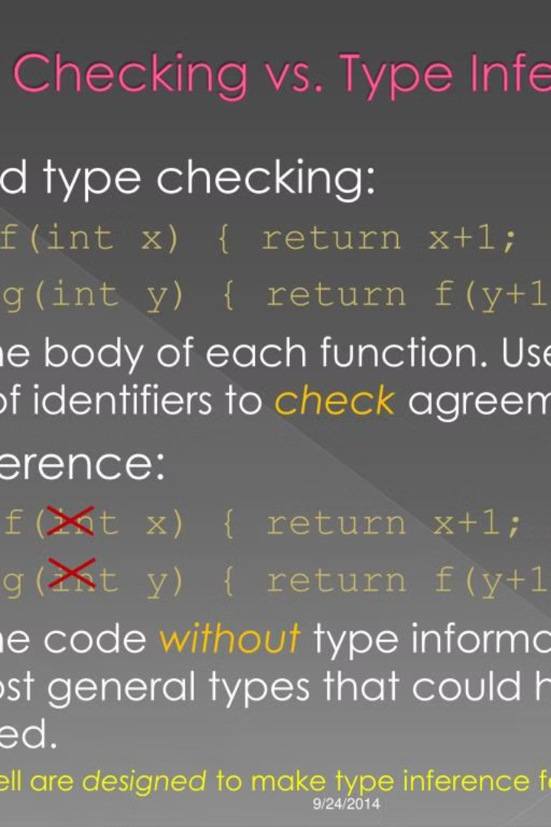
Type Checking and Inference
Type checking and inference are crucial static analysis techniques used in modern compiler design.
Type checking ensures that variable and expression types are valid, avoiding runtime errors.
Type inference automatically deduces the types of variables, reducing the burden on the programmer.
These techniques enable more robust and efficient code generation, resulting in higher-quality and more reliable software.
By catching type-related issues early in the compilation process, compilers can optimize code and generate better machine code.

Slide 7
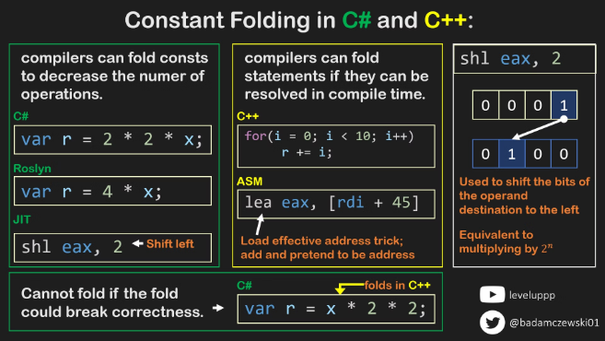
Constant Folding and Propagation
Constant folding is an optimization technique that evaluates expressions with constant operands at compile-time, replacing them with their computed values.
This reduces the amount of computation required at runtime, leading to faster execution.
Constant propagation analyzes the flow of constant values through a program and replaces variables with their constant values where possible.
This can enable further optimizations like dead code elimination.

Slide 8
Dead Code Elimination
1
Identify Unused Code
2
Remove Unnecessary Instructions
Analyze the control flow and data dependencies to identify code that is never executed or has no impact on the program's output.
Eliminate dead code to reduce the size of the executable, improve performance, and enhance maintainability.
3
Optimize Compile-Time
4
Improve Static Analysis
Dead code elimination can reduce the time and resources required during the compilation process, leading to faster build times.
Removing dead code helps static analysis tools provide more accurate and relevant information about the program structure and behavior.

Slide 9




Loop Optimizations
Loop Unrolling
Unroll loops to reduce iteration overhead and enable further optimizations like SIMD parallelization.
Loop Invariant Code Motion
Move code that doesn't change within a loop out of the loop to avoid redundant computations.
Loop Fusion
Combine multiple loops that operate on the same data into a single loop to improve cache utilization.

Slide 10
Register Allocation Strategies
Efficient register allocation is a critical component of modern compiler design, ensuring optimal utilization of a computer's limited number of registers. Compilers employ a variety of strategies to address this challenge, each with its own strengths and trade-offs.
Managing Register Usage
Compilers must carefully balance register pressure, avoiding spills to memory that can significantly impact performance.
Allocation Algorithms
Advanced heuristic-based algorithms, such as graph coloring, are used to map program variables to physical registers.

Slide 11
After optimization
#include <stdio.h>
int factorial(int n) {
int result = 1;
while (n > 1) {
result *= n;
n--;
}
return result;
}
int main() {
int num = 5; // Input value
int result = factorial(num); printf("Factorial of %d is %d\n", num, result);
return 0;
}
Before optimization
#include <stdio.h>
int factorial(int n) {
if (n <= 1) {
return 1;
} else {
return n * factorial(n - 1);
}
}
int main() {
int num = 5;
int result = factorial(num);
printf("Factorial of %d is %d\n", num, result);
return 0;
}

Slide 12
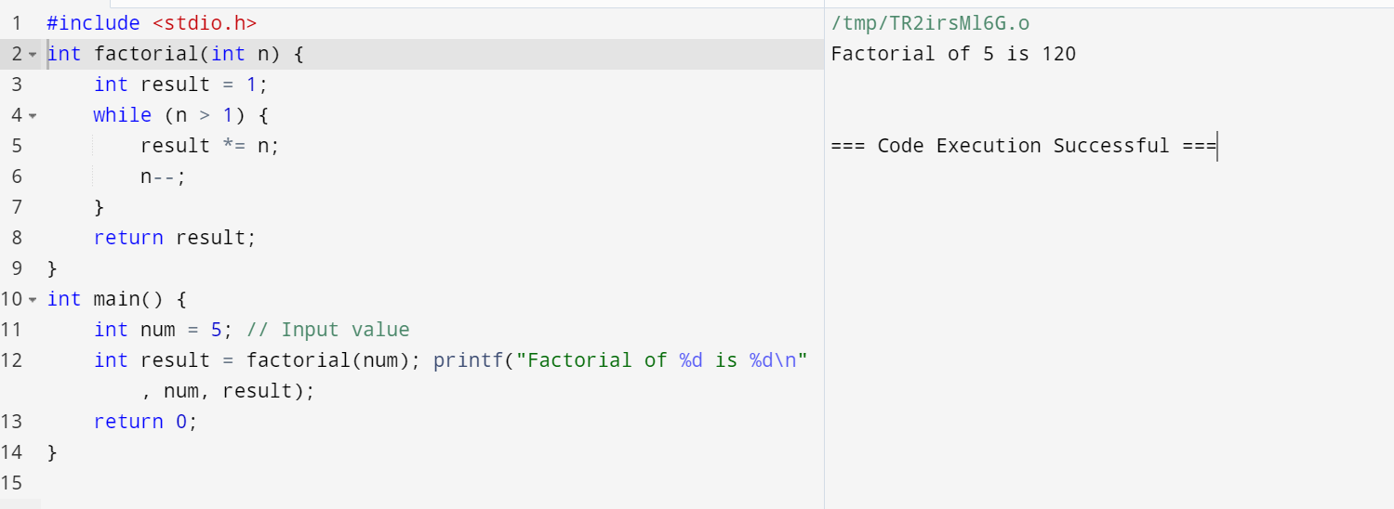
OUTPUT

Slide 13

Conclusion and Future Directions
In conclusion, this presentation has explored the critical role of static analysis and code optimization techniques in modern compiler design. By leveraging advanced algorithms and data structures, compilers can significantly improve the performance and efficiency of software applications.
Looking to the future, emerging trends such as machine learning-driven optimizations and the rise of domain-specific languages promise to further transform the field of compiler design. As software systems grow in complexity, the need for innovative compiler technologies will only continue to increase.

Slide 14


